Slide 1
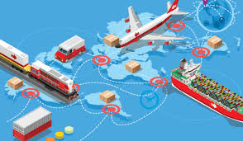
Unit 3 Chapter 3
INTERDEPENDENCE
AND
GAINS FROM TRADE

Slide 2
A PARABLE FOR THE MODERN ECONOMY
Why do people choose to depend on each other?
Example of Ruby and Frank and two goods
Need for interdependence: everyone does not have adequate resources or skills to produce goods and services and meet all their wants
Self-sufficiency and specialisation
Specialisation ensures a greater variety of goods and services
What if one agent is better at producing both commodities?

Slide 3
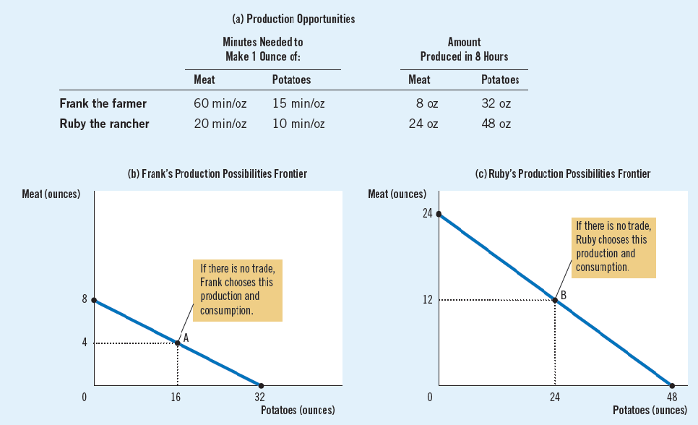
A PARABLE FOR THE MODERN ECONOMY
Ruby is better at both

Slide 4
A PARABLE FOR THE MODERN ECONOMY
Straight line PPF indicating constant opportunity costs
Recall the bow-shaped PPFs in the second chapter
If Frank and Ruby choose to be self-sufficient rather than trade with each other, then each consumes exactly what he or she produces
PPFs also define the consumption frontier as well
Suppose Frank produces and consumes 16 units of potato, and 4 units of meat..
Ruby produces and consumes 24 units of potato and 12 units of meat..

Slide 5
A PARABLE FOR THE MODERN ECONOMY
Ruby and Frank come to a deal
Frank produces only potatoes, 8 hours = 32 units of potatoes
Ruby spends allocates time for meat and potato
6 hours = 18 units of meat ; 2 hours = 12 units of potato
Ruby and Frank exchange 5 units of meat and 15 units of potato for each other, respectively
Ruby has 13 units of meat and 27 units of potatoes (12 + 15)
Frank has 17 units of potatoes and 5 units of meat

Slide 6
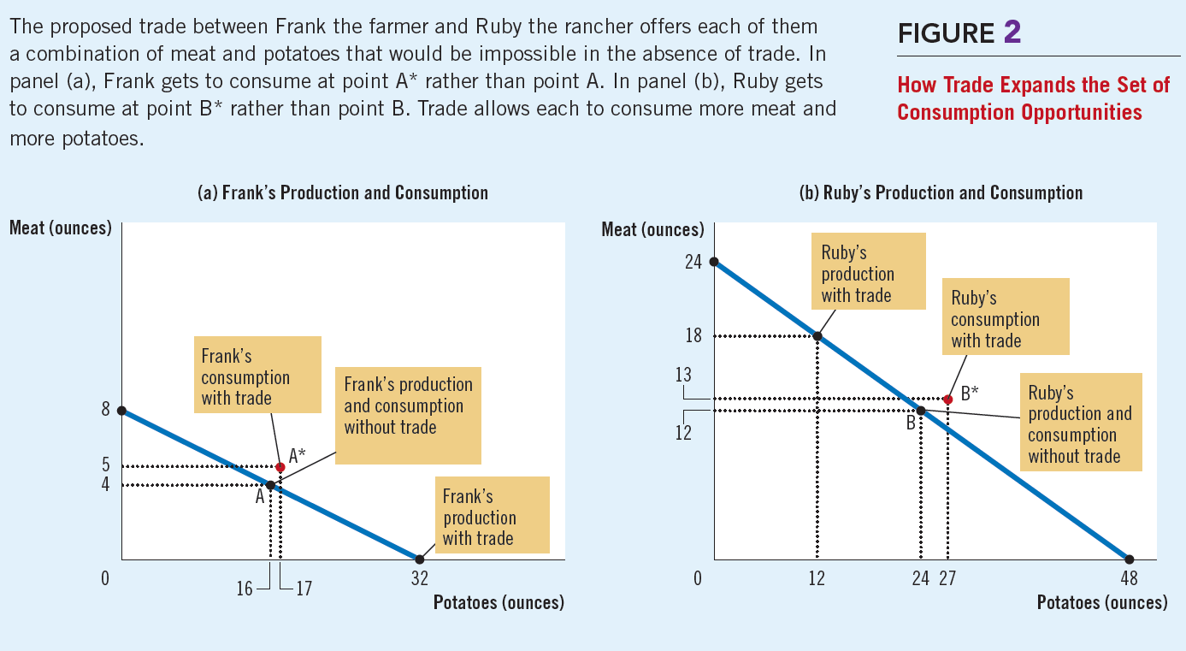
A PARABLE FOR THE MODERN ECONOMY

Slide 7
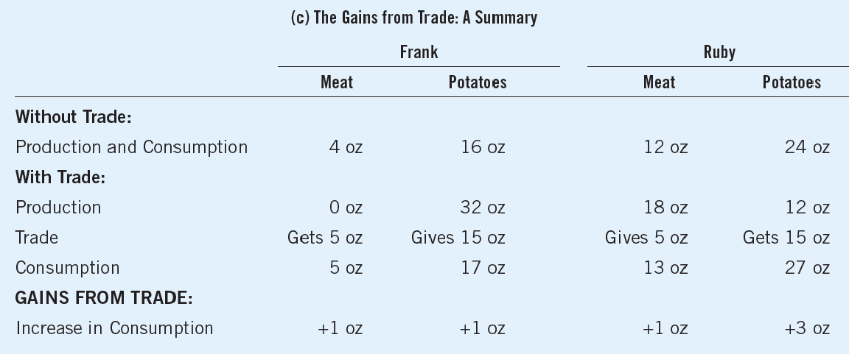
A PARABLE FOR THE MODERN ECONOMY
Specialisation and exchange lead to mutual benefits and gains from trade

Slide 8
COMPARATIVE ADVANTAGE: THE DRIVING FORCE OF SPECIALIZATION
If Ruby is good at producing meat and potatoes, how can Frank specialise in something, at all?
Answer lies in the principle of comparative advantage
Pre-requisite for comparative advantage is the concept of absolute advantage
Adam Smith developed the concept of absolute advantage to justify free trade between Britain and its colonies
An agent can gain by specializing and exchanging the commodity of absolute advantage, for the commodity of absolute disadvantage with the other agent

Slide 9
COMPARATIVE ADVANTAGE: THE DRIVING FORCE OF SPECIALIZATION
Concept of absolute advantage
To compare the productivity of one person, firm, or nation to that of another
Comparing the cost of producing potatoes by comparing the inputs required by the two producers
Producer requiring smaller units of inputs has an absolute advantage
Time or labour time is the input
Ruby takes lesser time than Frank in producing meat and potato
Ruby has an absolute advantage in both

Slide 10
COMPARATIVE ADVANTAGE: THE DRIVING FORCE OF SPECIALIZATION
Concept of comparative advantage
To compare the opportunity costs of producing one unit of a commodity for one person, firm, or nation to that of another
Time spent producing potatoes takes away from time available for producing meat
Ruby’s opportunity cost of producing potato =
In 10 minutes, Ruby produces 1 unit of potato or ½ unit of meat
In 8 hours, 48 P = 24 M; P = ½ M [ M = 2 P]
Frank’s opportunity cost of producing potato =
In 15 minutes, Frank produces 1 unit of potato or ¼ unit of meat
In 8 hours, 32 P = 8 M; P = ¼ M [ M = 4 P]

Slide 11
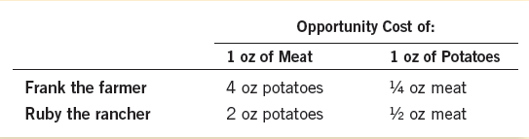


COMPARATIVE ADVANTAGE: THE DRIVING FORCE OF SPECIALIZATION
Comparative advantage: the ability to produce a good at a lower opportunity cost than another producer
The producer who has lower opportunity costs in potatoes has a comparative advantage in it
Frank has a comparative advantage in potatoes, and Ruby has a comparative advantage in meat

Slide 12
COMPARATIVE ADVANTAGE: THE DRIVING FORCE OF SPECIALIZATION
Gains from trade are based on comparative advantage
Total production of potatoes rises to 44 units from 40 units
Total production of meat rises to 18 units from 16 units
Prices under trade are lower than the opportunity cost
Frank: 5 units of meat for 15 units of potatoes (1 M = 3 P)
Opportunity cost was 1 M = 4 P
Ruby: 15 units of potatoes for 5 units of meat (1 P = 1/3 M)
Opportunity cost was 1 P = ½ M
Trade can benefit everyone in society because it allows people to specialize in the activities in which they have a comparative advantage

Slide 13
COMPARATIVE ADVANTAGE: THE DRIVING FORCE OF SPECIALIZATION
What determines the price in trade and how are the gains shared
For both agents to gain from trade, the price at which they trade must lie between their opportunity costs
Ruby and Frank trade at 3 units of potatoes for 1 unit of meat
This lies in the range of 2P – 4P
If the price of trade lies outside the range………
Any price below 2: both agents want to BUY meat
Any price above 4: both agents want to SELL meat
A two agents economy cannot have only buyers or only sellers

Slide 14
APPLICATION IN INTERNATIONAL TRADE
Should a country engage in trade with other countries?
Goods produced abroad and sold domestically are called imports
Goods produced domestically and sold abroad are called exports
Suppose there are two countries, the USA and Japan, and two goods, food and cars
A labourer from the USA and Japan can produce 1 car a month: equally productive
A labourer from the USA can produce 2 tons of food and a labourer from Japan can produce only 1 ton of food per month
As per comparative advantage, whichever country has lower opportunity costs in a commodity, should produce that one

Slide 15


APPLICATION IN INTERNATIONAL TRADE
Countries | Opportunity costs of producing a car | Opportunity costs of producing 1 ton of food
USA | 2 tons of food | ½ car
Japan | 1 ton of food | 1 car
Practically trade issues are more complex and can have some adverse effects for some sections of individuals
Overall, trade policies are devised in such a way that the adverse effects are minimized

